Slide 1
Chapter 2 Approaches to System Development

Slide 2
Chapter Two Outline
System Development Methods
The System Development Life Cycle
Agile Development
Iterative Development

Slide 3
Overview
There are various approaches to system development.
Each one offers a unique set of principles for designing, building, and maintaining information systems.
Selecting an approach depends on various factors, including the type of the system under development, organisational culture, and project requirements.

Slide 4
System Development Methods
The most popular approach for developing information systems include:
structured approach – a traditional method that is still widely used
object-oriented (O-O) – a more recent approach that many analysts prefer
agile methods, also called adaptive methods include the latest trends in software development.

Slide 5
 | STRUCTURED APPROACH | OBJECT-ORIENTED APPROACH | AGILE/ADAPTIVE METHODS
Description | Represents the system in terms of data and the processes that act upon that data. System development is organized into phases, with deliverables and milestones to measure progress. | Views the system in terms of objects that combine data and processes. The objects represent actual people, things, transactions, and events. Compared to structural analysis, O-O phases tend to be more interactive. | Stresses intense team-based effort. Breaks development into cycles, or iterations, that add functionality. Each cycle is designed, built, and tested in an ongoing process.

Slide 6
 | STRUCTURED APPROACH | OBJECT-ORIENTED APPROACH | AGILE/ADAPTIVE METHODS
Modelling tools | Data flow diagrams (DFDs) and process descriptions. Also, business process modelling. | Various object-oriented diagrams depict system actors, methods, and messages. Also, business process modelling. | Tools that enhance communication, such as collaborative software, brainstorming, and whiteboards. Business process modelling works well with agile methods.

Slide 7
 | STRUCTURED APPROACH | OBJECT-ORIENTED APPROACH | AGILE/ADAPTIVE METHODS
Pros | Traditional method that has been very popular over time. Relies heavily on written documentation. Frequent phase iteration can provide flexibility comparable to other methods. Well-suited to traditional project management tools and techniques. | Integrates easily with object-oriented programming languages. Code is modular and reusable, which can reduce cost and development time. Easy to maintain and expand because new objects can be created using inherited properties. | Very flexible and efficient in dealing with change. Stresses team interaction and reflects a set of community-based values. Frequent deliverables constantly validate the project and reduce risk.

Slide 8
 | STRUCTURED APPROACH | OBJECT-ORIENTED APPROACH | AGILE/ADAPTIVE METHODS
Cons | Changes can be costly, especially in later phases. Requirements are defined early, and can change during development. Users might not be able to describe their needs until they can see examples of features and functions. | Somewhat newer method might be less familiar to development team members. Interaction of objects and classes can be complex in larger systems. | Team members need a high level of technical and communications skills. Lack of structure and documentation can introduce risk factors. Overall project might be subject to scope change as user requirements change.

Slide 9

2.2 Structured Development Approach

Slide 10
2.2 Structured Development Approach
This approach is a traditional systems development technique that is time-tested and easy to understand
Structured analysis uses a series of phases called the systems development life cycle , to plan, analyse, design, implement, and support an information system
Structured approach is based on an overall plan, like a blueprint for constructing a building, so it is called a predictive approach
The structured development approach includes structured analysis and structured design

Slide 11
2.2 Structured Development Approach cont…
It focuses on processes that transform data into useful information.
Structured analysis is called a process-centred technique.
Structured analysis uses a set of process models to describe a system graphically.
A process model shows the data that flows in and out of system processes.

Slide 12
2.2.1 Function Hierarchy Charts
A function hierarchy chart shows decomposition of system into modules using a treelike structure
It is a kind of top-down design that considers the system as its root level and breaks down the system into modules
It specifies the high-level design of the system; hence, it is called high-level design or systems design
The system should be decomposed in such a way that most of its modules have minimal dependency on each other

Slide 13
Function hierarchy chart is also known as function decomposition diagram (FDD)
FDD shows:
size and complexity of the system
number of modules in it
coupling (relationship) between the modules in hierarchical fashion
modules must have minimal dependency (coupling) on each other

Slide 14
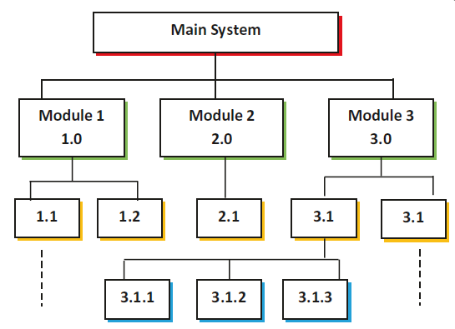
Figure 3.1: Function decomposition diagram (FDD) structure

Slide 15
Function decomposition diagram of Student Registration System
Student Registration System
Select Course
Pay Fee
Produce Schedule
Produce Class Roaster
Produce enrolment Report
Add New Course
Modify Course
Delete Course
Produce Course List

Slide 16
Modules must be as independent as possible to avoid development and usage difficulties.
The internal logic and relationship (bond) between components of a module must be strong.
The internal strength of a module is known as cohesion.
The cohesion is desired to be maximum (as high as possible), and coupling is desired to be minimum (as low as possible).

Slide 17
Group students for the following exercise
Student admission system – GROUP 1
Automated Teller Machine (ATM) – GROUP 2
Virtual class – GROUP 3
Library management system – GROUP 4
Who will use the game/system?
What will the game/system do?
Draw functional decomposition diagram

Slide 18
2.2.2 The System Development Life Cycle
The system development life cycle (SDLC) is a framework that identifies all the activities required to research, build, deploy, and maintain an information system.
Normally, the SDLC includes all activities needed for the planning, systems analysis, systems design, programming, testing, and user training stages of information systems development.

Slide 19
2.2.2 The System Development Life Cycle
1. Identify the problem or need and obtain approval to proceed with the project
2. Plan and monitor the project—what to do, how to do it, and who does it
3. Discover and understand the details of the problem or the need—what is required?
4. Design the system components that solve the problem or satisfy the need—how will it work?
5. Build, test, and integrate system components—lots of programming and component integration
6. Complete system tests and then deploy the solution—the need now is satisfied

Slide 20
2.2.3 Predictive Approaches to SDLC
A predictive approach to the SDLC assumes that the development project can be planned and organized, and that the new information system can be developed according to the plan
Predictive SDLCs are useful for building systems that are well understood and defined
These six groups of activities—project initiation, project planning, analysis, design, implementation, and deployment—are sometimes referred to as phases of the system development project, and they provide the framework for managing the project
The most predictive SDLC approach is called a waterfall model, with the phases of the project flowing down, one after another

Slide 21
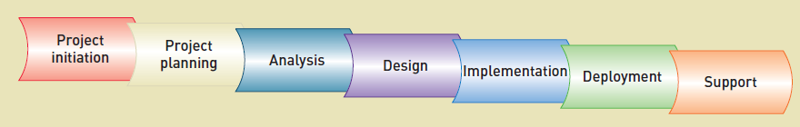
Figure 2-1 Traditional information system development phases (with support phase)
SDLC phase | Objective
Project initiation | Identifies the problem and secures approval to develop a new system
Project planning | To identify the scope of the new system, ensure that the project is feasible, and develop a schedule, resource plan, and budget for the remainder of the project
Analysis | To understand and document in detail the business needs and the processing requirements of the new system
Design | To design the solution system based on the requirements defined and decisions made during analysis
Implementation | To build and test a reliable information system
Deployment | Installing, training, and putting the system into operation
Support | To keep the system running productively, both initially and during the many years of the system’s lifetime

Slide 22
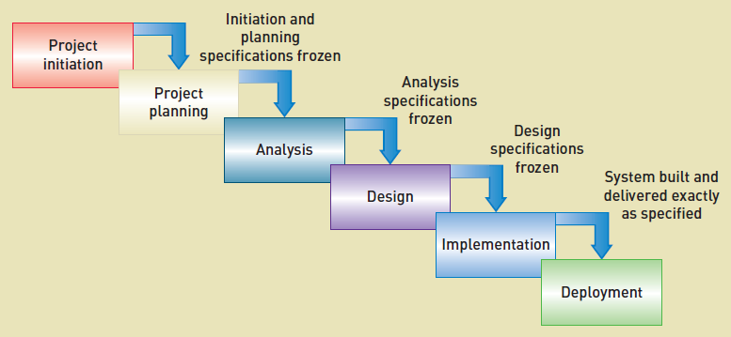
The most predictive SDLC approach is called a waterfall model, with the phases of the project flowing down, one after another.
Figure 2-2 Waterfall model of the SDLC

Slide 23
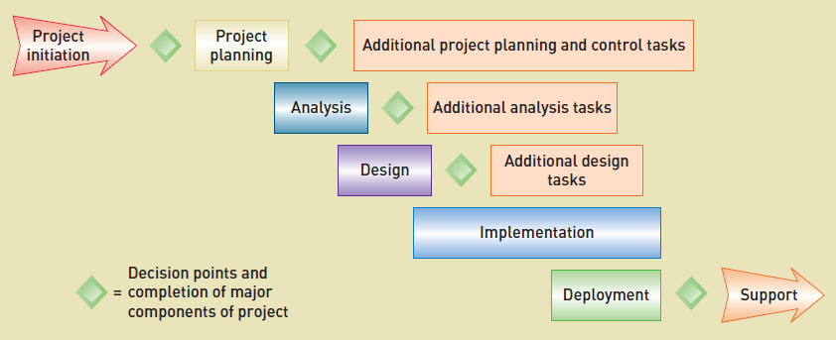
Figure 2-3 illustrates how these activities can overlap.
Figure 2-3 Overlap of system development phases

Slide 24
2.2.4 Adaptive Approach to SDLC
An adaptive approach to the SDLC is used when the system’s requirements and/or the users’ needs are not well understood
Developers should still be able to build the solution, but they need to be flexible and adapt the project as it progresses
This iterative approach is adaptive because with each iteration’s analysis, design, and implementation, modifications can be made to adapt to the changing requirements of the project
The adaptive approach presented in this textbook is a simplification of and variation on a more formal iterative approach called the Unified Process
The advantage of this approach is that portions of the system get into the users’ hands much sooner so the business can begin accruing benefits as early as possible

Slide 25
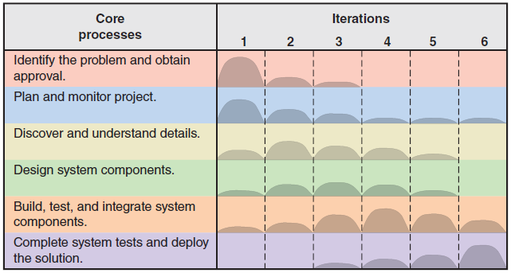
Figure 2-4 Adaptive SDLC with six core processes and multiple iterations
The core processes are carried out in each iteration of the project.
This iterative approach is adaptive because with each iteration, analysis, design, and implementation, modifications can be made to adapt to the changing requirements of the project.

Slide 26
2.2.5 Methodologies, Models, Tools, and Techniques
Aside from an SDLC, systems developers have a variety of aids at their disposal to help them complete activities and tasks
Among them are methodologies, models, tools, and techniques

Slide 27
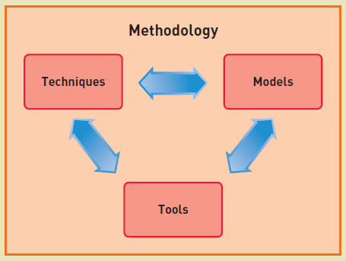

Slide 28
METHODOLOGIES
A system development methodology provides guidelines for every facet of the system development life cycle
Project methodologies provide a systematic way to plan, manage, and execute the work to be completed by prescribing phases, processes, tools, and techniques to be followed
The methodology used by the organization determines how predictive or adaptive the approach to a system development project should be

Slide 29
TOOLS
In the context of system development, a tool is software support that helps create models or other components required in the project.
Visual modelling tools are available to systems analysts to help them create and verify important system models

Slide 30
TECHNIQUES
In system development, a technique is a collection of guidelines that helps an analyst complete an activity or task
It often includes step-by-step instructions for creating a model, or it might include more general advice on collecting information from system users
Examples include data-modelling techniques, software-testing techniques, user-interviewing techniques, and relational database design techniques

Slide 31
2.3 Object-Oriented Analysis
Object-oriented analysis describes an information system by identifying things called objects
Whereas structured analysis treats processes and data as separate components, object-oriented analysis combines data and the processes that act on the data into things called objects
Object-oriented analysis is a popular approach that sees a system from the viewpoint of the objects themselves as they function and interact
The product of O-O analysis is an object model, which represents the information system in terms of objects and O-O concepts
In O-O design, built-in processes called methods can change an object's properties
O-O analysis uses object models to represent data and behaviour, and to show how objects affect other objects
Object-oriented methods usually follow a series of planning, analysis and design phases that are similar to the SDLC, although there is less agreement on the number of phases and their names

Slide 32
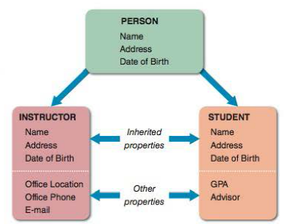
An object is a member of a class, which is a collection of similar objects.
Objects possess characteristics called properties, which the object inherits from its class or possesses on its own.
Figure 2-6 The PERSON class includes INSTRUCTOR and STUDENT objects, which have their own properties and inherited properties

Slide 33
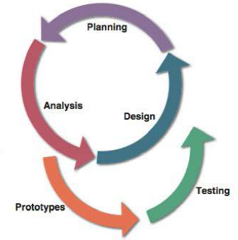
Figure 2-7 In a typical O-O development model, planning, analysis, and design tasks interact continuously to generate prototypes that can be tested.
Object-oriented methods usually follow a series of planning, analysis and design phases that are similar to the SDLC
O-O model phases are more interactive where planning, analysis, and design tasks interact to produce prototypes that can be tested and implemented.

Slide 34
2.4 Agile Development
Highly volatile business environment has forced businesses to respond rapidly to new opportunities.
The basic philosophy of Agile development is that neither team members nor the users completely understand the problems and complexities of a new system, so the project plan and the execution of the project must be responsive to unanticipated issues
Agile development is an information system development process that emphasizes flexibility and rapid response to anticipate new and changing requirements during development.
Agile methods attempt to develop a system incrementally, by building a series of prototypes and constantly adjusting them to user requirements.
An agile approach emphasizes continuous feedback, and each incremental step is affected by what was learned in the prior steps
Developers revise, extend, and merge earlier versions into the final product based on continuous feedback.

Slide 35
2.5 Iterative Development
Iterative development is an approach to system development in which the system is “grown” piece by piece through multiple mini projects called iterations
Core functions that provide basic support for users can be deployed in an early iteration.
Core components are developed first and then additional components are added.
It is called iterative because the six core development processes are repeated for each component
Portions of the system can sometimes be deployed sooner.

Slide 36
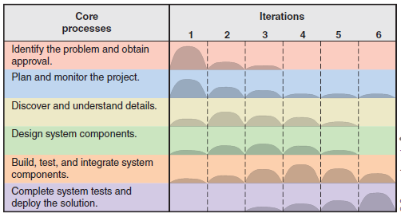
Figure 2-11 The six core processes of the SDLC showing iterations
Iteration 1 appears to primarily focus on identifying the problem and planning the project.
Lesser amounts of discovery, design, and build/test may also be done.
For this iteration, nothing is done with regard to deploying the system.

Slide 37
2.6 Alternative System Building Approaches
Two methodologies became popular: joint application development and rapid application development
Both JAD and RAD use teams composed of users, managers, and IT staff
The difference is that JAD focuses on team-based fact-finding, which is only one phase of the development process, whereas RAD is more like a compressed version of the entire process
One special instance of prototyping that uses an object-oriented approach is called rapid application development (RAD).
Prototyping and RAD can also be used as an alternative method to SDLC.
Prototyping produces an early, rapidly constructed working version of the proposed information system, called a prototype.
Prototyping involves a repetitive sequence of analysis, design, modelling, and testing.

Slide 38
PROTOTYPING METHODS
Systems analysts use two different prototyping methods: system prototyping and design prototyping
While agile methods represent the latest approach to system prototyping, rapid application development remains a popular strategy
Systems analysts also use prototyping to verify user requirements, after which the prototype is discarded, and implementation continues
System prototyping produces a full-featured, working model of the information system.
This approach is called design prototyping, or throwaway prototyping.

Slide 39
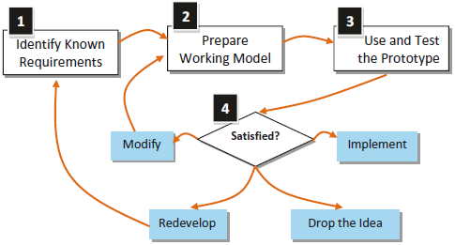
STEPS OF PROTOTYPING

Slide 40
STEPS OF PROTOTYPING
Both the Systems Analyst and users collect available requirements and document them formally
Users and Systems Analyst identify the system's objective, basic input/output, selected functionalities, data required, and other requirements
The second step of prototyping is to build a working model using the collected requirements
Programming languages , reporting tools, Computer-Aided Software Engineering tools, etc. are a few popular tools for prototyping
While developing the system's working model, users are involved with the development process; however, the responsibility of the development is on the Systems Analyst or the developer committee

Slide 41
Advantages of Prototyping
the potential for changing the system early in its development
the opportunity to stop development of a system that is not working
the possibility of developing a system that more closely addresses users’ needs and expectations

Slide 42
Disadvantages of Prototyping
The first is that it can be quite difficult to manage prototyping as a project in the larger systems effort
The second disadvantage is that users and analysts may adopt a prototype as a completed system when it is in fact inadequate and was never intended to serve as a finished system
The analyst needs to weigh these disadvantages against the known advantages when deciding whether to prototype, when to prototype, and how much of the system to prototype

Slide 43
Users’ Role in Prototyping
There are three main ways a user can be of help in prototyping:
Experimenting with the prototype.
Giving open reactions to the prototype.
Suggesting additions to or deletions from the prototype.

Slide 44
The following types of applications can be considered as candidate applications for the prototype development approach:
System incorporating novel technologies and procedures, which requires user’s approval.
High-cost and high-risk type of systems.
Requirements of the systems to be developed are not known.
Systems that required to be checked for their feasibilities.

Slide 45
END

